Slide 1
REGULAR EXPRESSIONS

Slide 2
Definition
A method of specifying a search string using a number of special characters that can precisely match a substring.
Purpose: These allow you to perform complex pattern matching on strings.
A small regular expression can replace the need for a large amount of code

Slide 3
TYPES
PHP offers functions specific to two sets of regular expression functions, each corresponding to a certain type of regular expression.
POSIX Regular Expressions
PERL Style Regular Expressions

Slide 4
POSIX RE
Brackets
Brackets ([]) have a special meaning when used in the context of regular expressions. They are used to find a range of characters.
Example:
Range [0-3] -> match any decimal digit ranging from 0 through 3.

Slide 5
QUANTIFIERS
Frequency or position of bracketed character sequences and single characters can be denoted by a special character.
+, *, ?, {int. range}, and $ flags all follow a character sequence.
Example:
p(hp)*- It matches any string containing a p followed by zero or more instances of the sequence php.

Slide 6
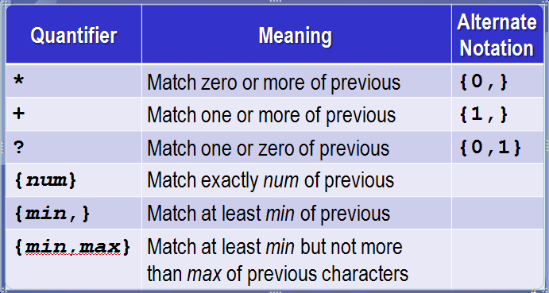

Slide 7
PERL STYLE RE
Similar to their POSIX.
Any of the quantifiers in POSIX can be used.
Meta characters
An alphabetical character preceded by a backslash that acts to give the combination a special meaning.
Eg: \d -> will search for any string of numerical character.

Slide 8
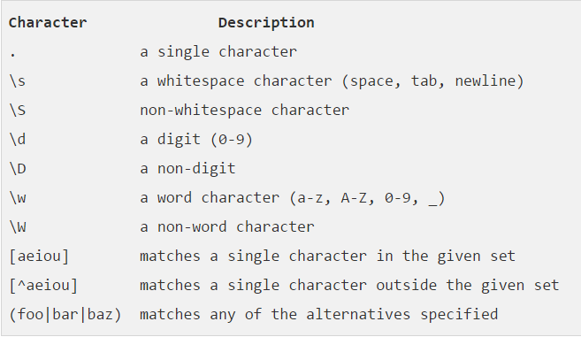
META CHARACTERS

Slide 9
MODIFIERS
Several modifiers are available that can make your work with regexps much easier, like case sensitivity, searching in multiple lines etc.
Example:
match upper and lower case “abc”:
'/abc/i'

Slide 10
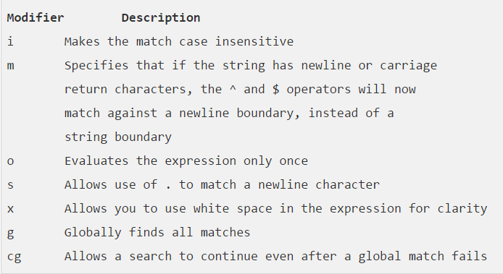

Slide 11
Example – Regular Expression
// Name
$patternName='/^[a-zA-Z]+/';
if (preg_match($patternName, $username))
echo "Valid <br>";
else
echo "Invalid <br>";

Slide 12
Example – Regular Expression
// Email
$patternEmail='/^[a-zA-Z0-9]+@[a-zA-Z0-9]+\.([a-zA-Z])+/';
if (preg_match($patternEmail, $useremail))
echo "Valid <br>";
else
echo "Invalid <br>";

Slide 13
Example – Regular Expression
//Gender
if (isset($usergender) && $usergender=="Male") echo "Male Checked <br>";
if (isset($usergender) && $usergender=="Female") echo "Female Checked <br>";

